Slide 1
Travelex: Augmented Reality using Google GeoFences
Addian García Betancourt
Obed N Munoz

Slide 2
Agenda
Introduction
Related work
Virtual Reality best practices for Tourism
Implementing Google Geofences
Business Opportunity
Impact of the Project
Future Work
Conclusions
Q & A

Slide 3
Introduction
Bum of smart devices
Smartphones
Tablets
Wearables
IoT
Augmented Reality in mobiles
Current Tourism needs
Techniques for Geo-Localization
Geofencing Technique
Location-Based Services

Slide 4
Virtual Reality best practices for Tourism
An Enhanced Booking Experience
Museum Interactivity
AR Browsers in the Destination
Responsive Experience Through Gaming
Services in the Restaurant
Re-living Historic Life and Events
The Hotel Experience
Transportation
Accessibility and Translation
Participative Destination Management

Slide 5
Related Work (PRISMA)
The main objective of PRISMA is the implementation of augmented binoculars, that combine the needs of tourists in real environments and Augmented Reality technologies. The use of these technologies will allow the users retrieving personalized and interactive multimodal information about monuments and historical buildings of a city.

Slide 6
Related Work (Gimbal)
the Gimbal project provides geofencing, secure proximity beacons, location-based messaging, analytics and consumer privacy controls.

Slide 7
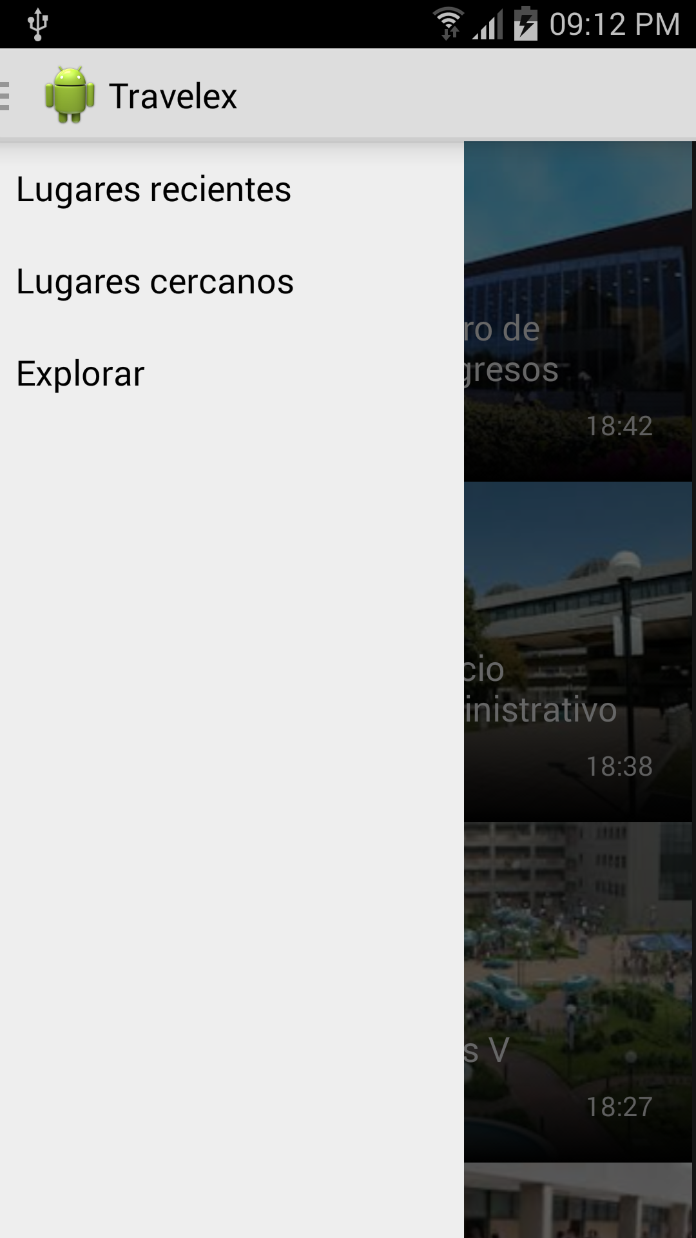
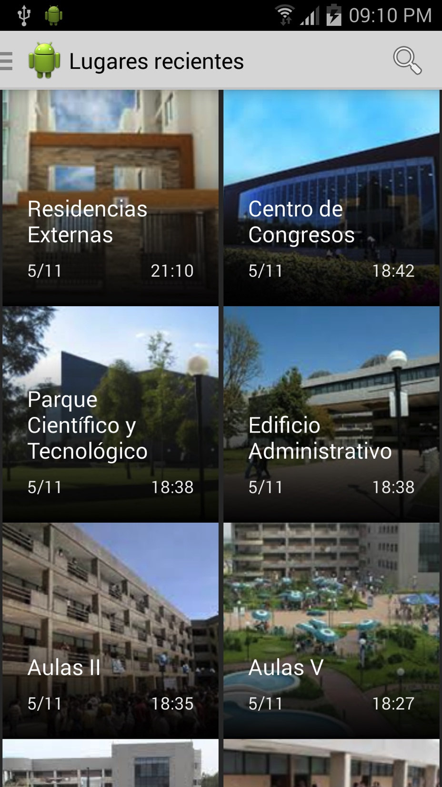
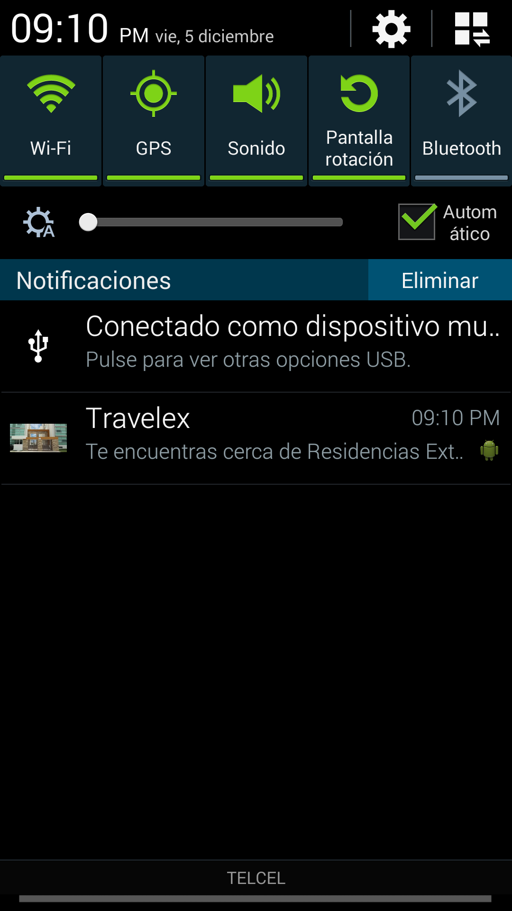
POC: Travelex

Slide 8
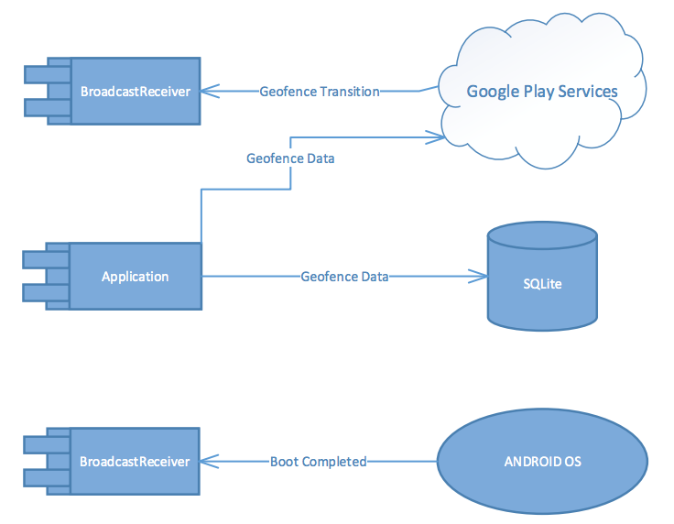
Travelex: Flow Chart

Slide 9
Business Opportunity
3 Business Models:
Paid app in Play Store
Purchases Inside the application
Adverts inside the app
Investment
Web Server for HTTP RestFul API
DB Server for storing data

Slide 10
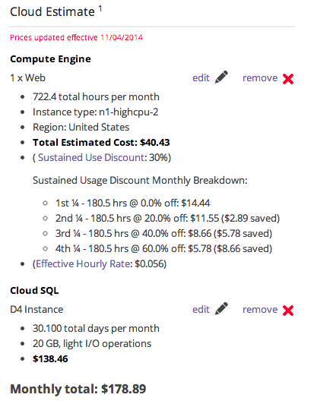

Hosting Expenses

Slide 11
Impact of the Project
Economic
Local businesses get more tourists on their destinations
More job opportunities due the demand of more services for tourists that are coming every vacation season
Social
Local culture is known around the world
Being role model in technology that is applied to improve the tourism
Tourists will feel comfortable because there’s a virtual assistant that will be there for directions to amazing places to visit

Slide 12
Future Work
Adding more touristic places
Enabling Explore capability that could let the users find more interesting places that are not necessary near to him/her.
Enabling ’Near Places’ capability
Adding feedback mechanism for letting users rate the destinations

Slide 13
Conclusions
Tourism as an area of opportunity for Augmented Reality applications
Geofencing as a combined technique with Augmented Reality for providing a better user experience
Google Geofences are an effective solution to the user localization problem: they are easy to use, configuration is made within the Android device, and Google Play Services takes care of the monitoring and entry/exit events.
Every day the need to Access the user location is more frequent, and the possibility to offer accurate information to the user is a big business opportunity in áreas such as advertisement, marketing, and tourism.

Slide 14
Questions?

